Slide 1
CHAPTER 1
Psychology Is a Way of Thinking

Slide 2
Research Producers, Research Consumers
Why the producer role is important
Why the consumer role is important
Benefits of being a good consumer?

Slide 3
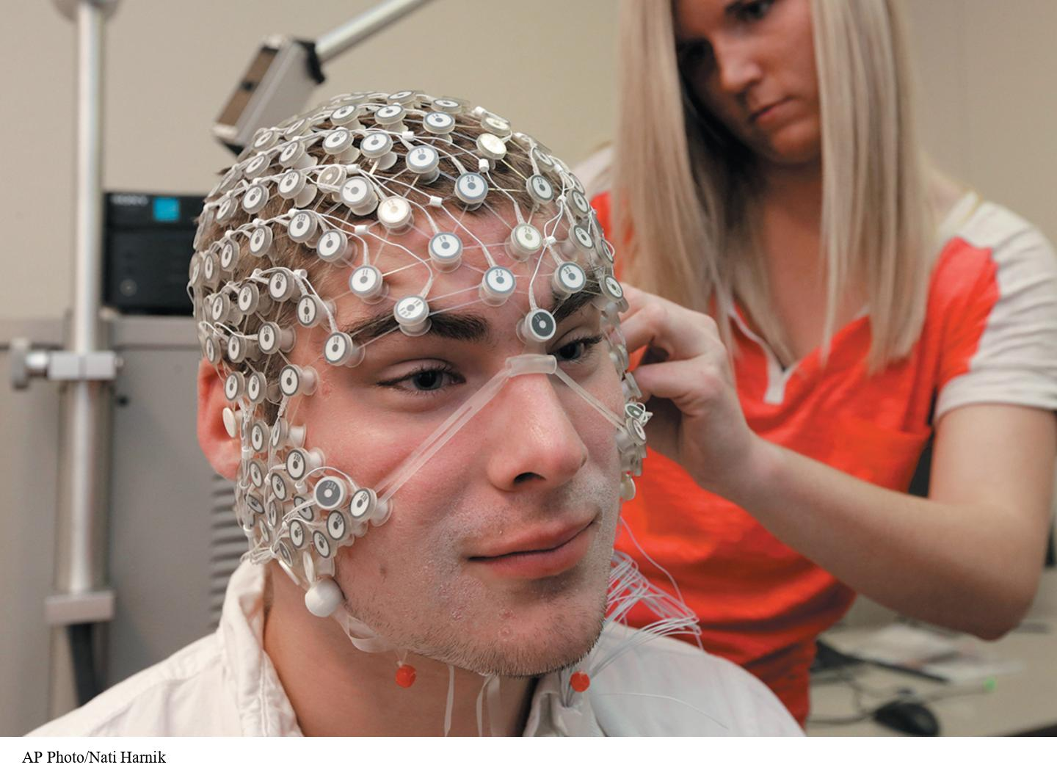
Why the Producer Role Is Important
For coursework in psychology
For graduate school
For working in a research lab
Notes:
Figure 1.1: Producers of Research
As undergraduates, some psychology majors work alongside faculty members as producers of information.
AP Photo/Nati Harnik

Slide 4
Why the Consumer Role Is Important
For psychology courses
When reading news stories based on research
For your future career
  Evidence-based treatment
Notes:
Invite students to share personal experiences about times when they have been consumers of research. Why was it important to them?
For psychology courses: Read psychological research studies published in scholarly journals—students need to be able to understand them.
News stories based on research: Ask what sorts of newspapers, magazines, websites, social media content, and other forms of media students consume that contain articles based on research. What sorts of topics do students like to research in the popular media (e.g., health, sex)? Being a savvy consumer of research will help you distinguish good research from bad research.
Future career: Ask students about their future career plans and how being a knowledgeable consumer of research might be helpful in their careers.
Evidence-based treatment is a therapy that is supported by research; for example, there is evidence based on scientific research that aerobic exercise can be an effective treatment for mild to moderate depression.

Slide 5
How Scientists Work
  Scientists are empiricists
  Scientists test theories: the theory-data cycle.
  Scientists work in a community.
  Scientists tackle applied and basic problems.
  Scientists make their work public.
  Scientists talk to the world: from journal to journalism.
Notes:
This section will explain what psychological scientists accomplish through conducting empirical investigations, testing theories, tackling applied and basic problems through research, digging deeper by trying to understand more about the research findings, and sharing their findings with the scientific community through journals and with the general public through journalism.

Slide 6
Scientists Are Empiricists
Empiricism (aka the empirical method or empirical research)
  Quantitative methods: turn empirical observations into numbers
  Qualitative methods: create rich descriptions not simplified into numbers
  Reflexivity: Scientists self-consciously consider how their background shapes what questions they ask and what interpretations they make.
Notes:
As you will see in Chapter 2, there are a variety of ways of knowing about the world based on intuition, experience, and authority. However, psychological scientists base their beliefs about psychology on empirical research. Empiricists base their conclusions on evidence from the senses or from instruments that can help the senses.

Slide 7
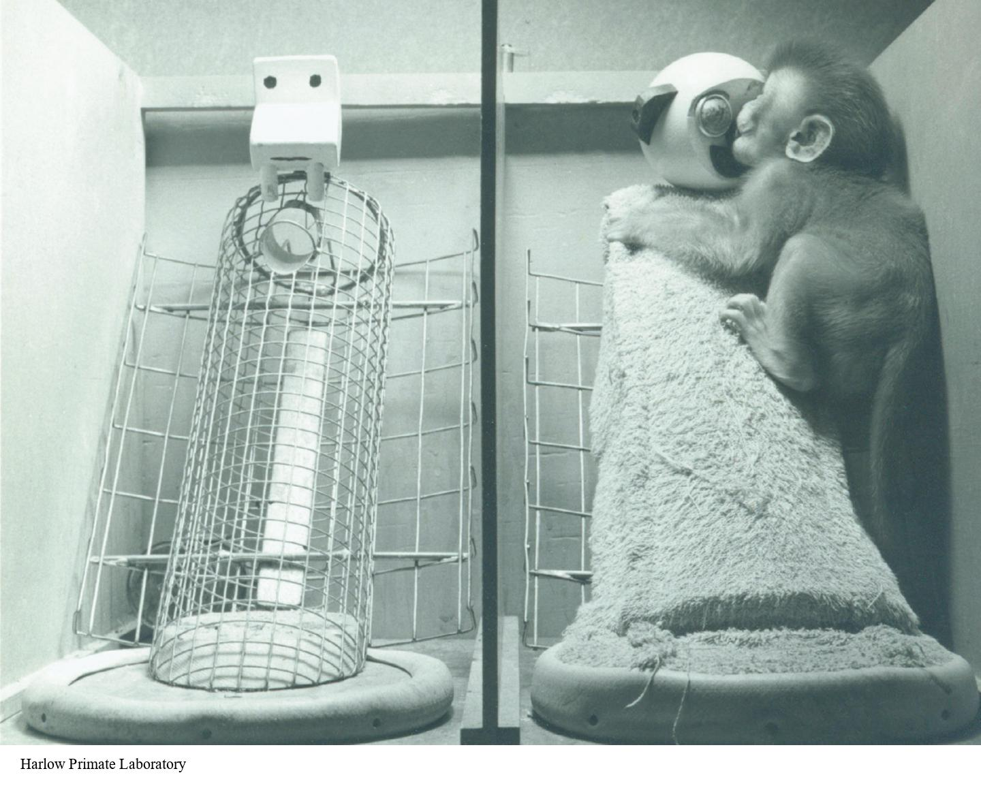
Scientists Test Theories: The Theory-Data Cycle (1 of 4)
Cupboard theory versus contact comfort theory
Notes:
Figure 1.4: The Contact Comfort Theory
As the theory led Harlow to hypothesize, the baby monkeys spent most of their time on the warm, cozy cloth mother, even though she did not provide any food.
The theory-data cycle involves asking questions that are based on theories, making predictions, and collecting and reflecting on data. This cycle is not only important in formal research situations but also in our everyday lives. Consider the example in the text about picking up your tablet to check e-mail but not being able to access your inbox. Go through the steps of the theory-data cycle.
Cupboard theory versus contact comfort theory: Harlow’s research is used here to illustrate how researchers use data to test their theories. There were two competing theories (cupboard theory and contact comfort theory) for explaining mother-infant attachment, but when Harlow (1958) tested these theories, the data supported the contact comfort theory.
Harlow Primate Laboratory

Slide 8
Hypotheses vs. Theories
Theory == broad, general explanation
Hypothesis == specific and testable
What does it mean for a hypothesis to be testable?
Examples?

Slide 9
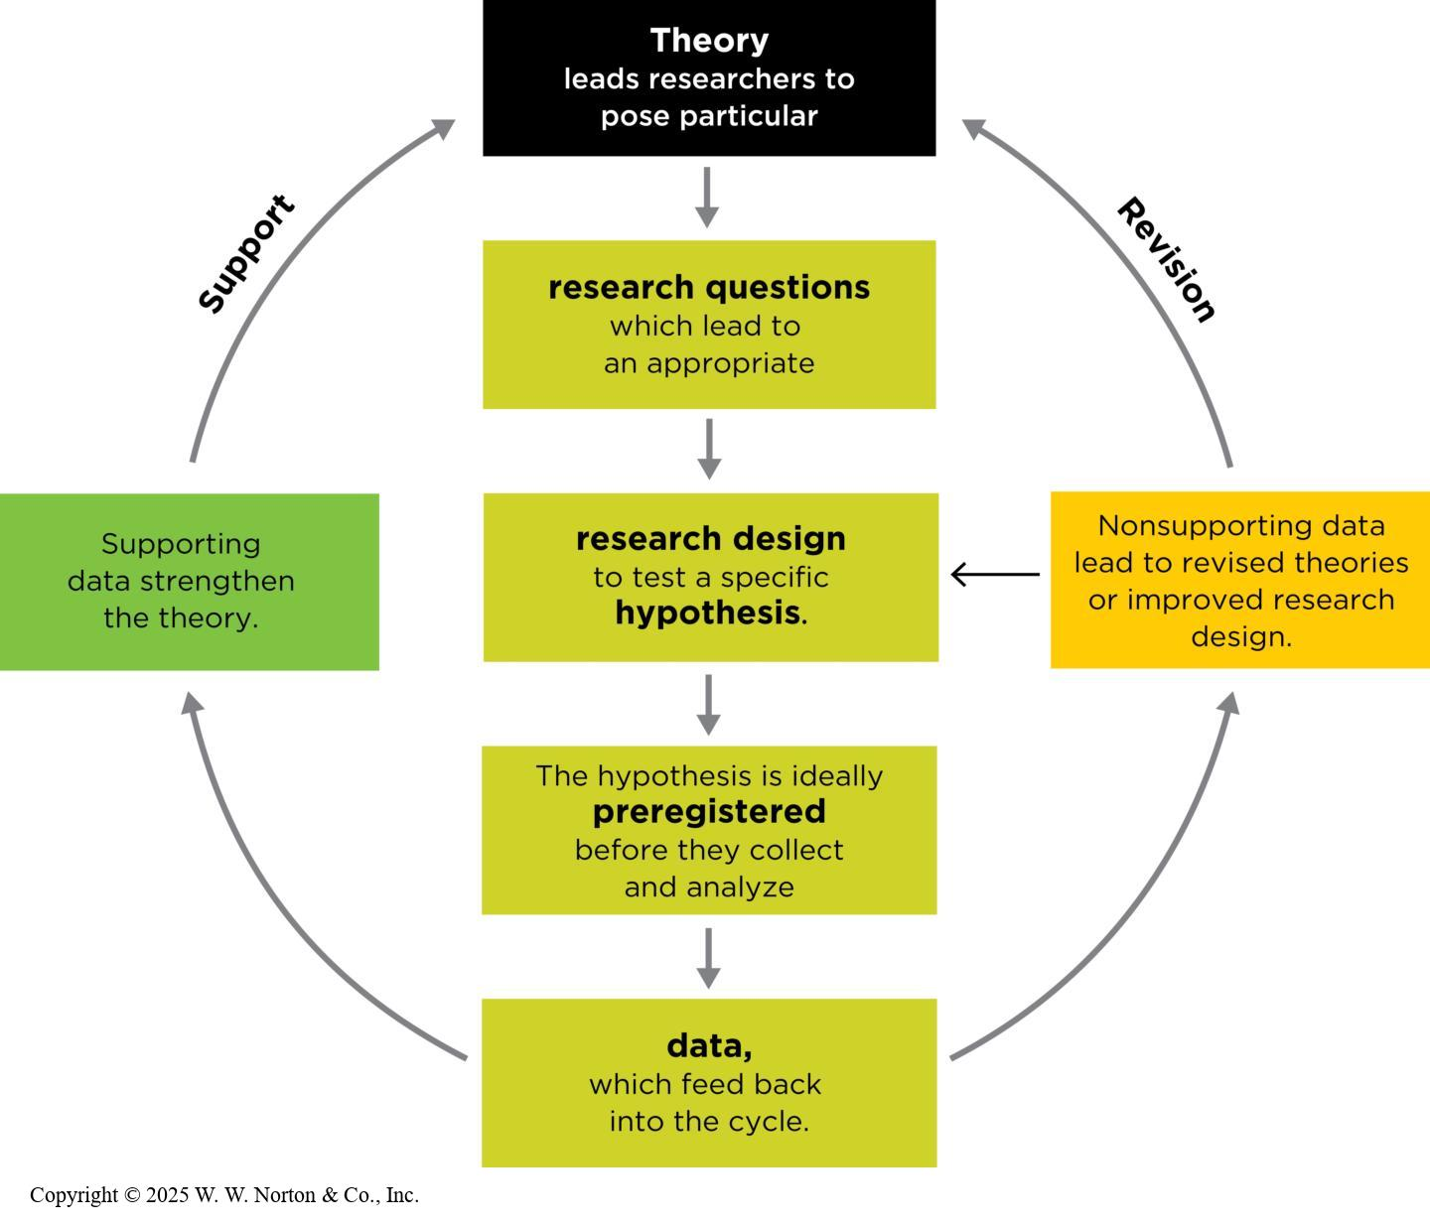
Scientists Test Theories: The Theory-Data Cycle (2 of 4)
Notes:
Figure 1.5: The Theory-Data Cycle
Theory: A set of statements that describes general principles about how variables relate to one another
Hypothesis: Predictions about the outcomes of your research based on theory
Data: Set of observations
Do the data support the hypotheses and strengthen the theory, or do not support the hypotheses and thus lead to either a revised theory or an improved research design?
Preregistered: A term referring to a study in which, before collecting any data, the researcher has stated publicly what the study’s outcome is expected to be
Copyright © 2025 W. W. Norton & Co., Inc.

Slide 10
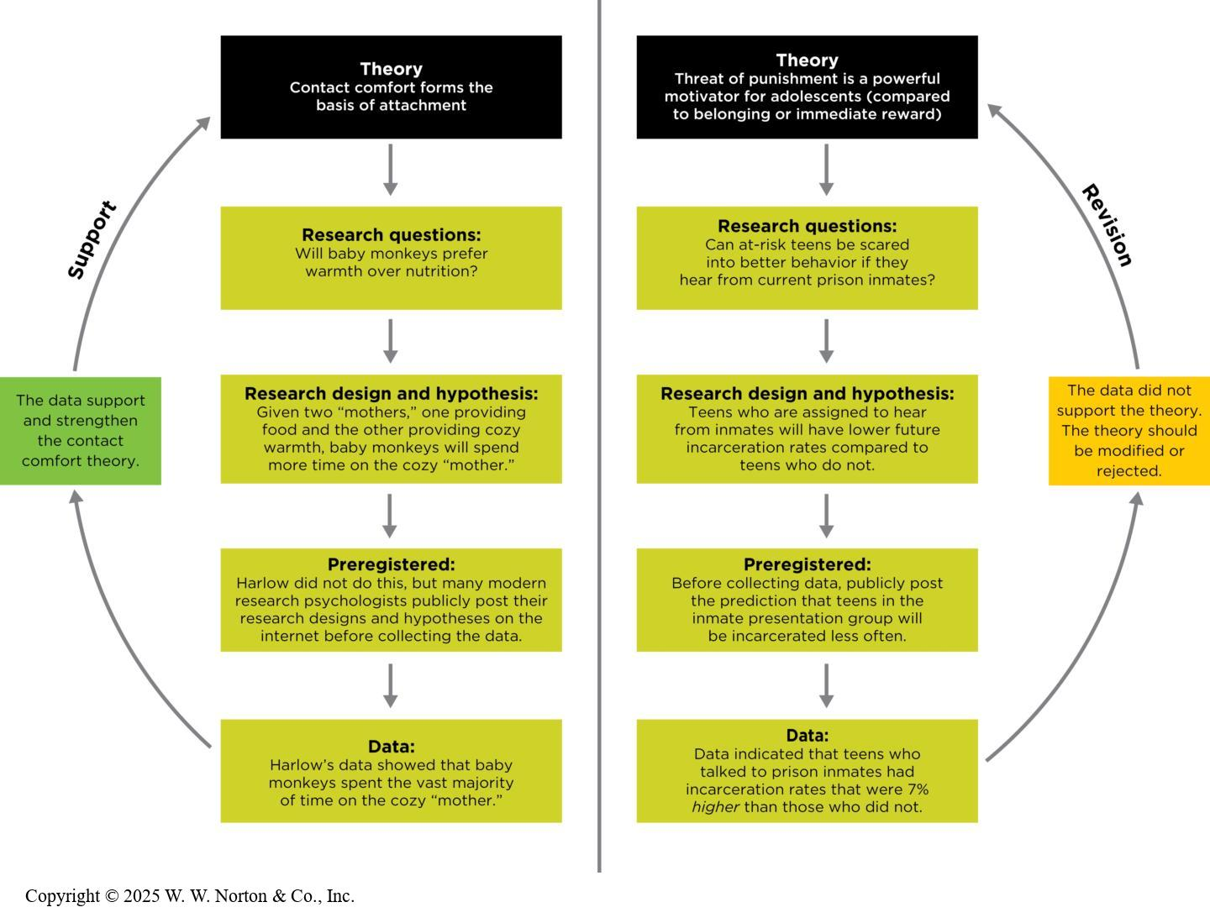
Scientists Test Theories: The Theory-Data Cycle (3 of 4)
Notes:
Figure 1.6: The Theory-data Cycle, Applied to Two Examples in this Chapter
On the left, the data supported the theory; on the right, the data contradicted the theory.

Slide 11
Scientists Test Theories: The Theory-Data Cycle (4 of 4)
Studies don’t prove theories.
Good theories are falsifiable.
Notes:
Replication: Describing a study whose results can be reproduced when the study is repeated, or replicated, which means it is reproducible
See also conceptual replication, direct replication, and replication-plus-extension in Ch. 14.
Weight of the evidence: A conclusion drawn from reviewing scientific literature and considering the proportion of studies that is consistent with a theory
Falsifiability: A theory must lead to hypotheses that, when tested, could actually fail to support the theory.
Don’t claim to “prove” anything: Do not use the word “prove” when referring to theories. Instead, psychological scientists opt for phrases such as “the data support or are consistent with a theory,” or “the data do not support or are inconsistent with a theory.” Scientists evaluate theories based on the weight of the evidence, for and against the theory.

Slide 12
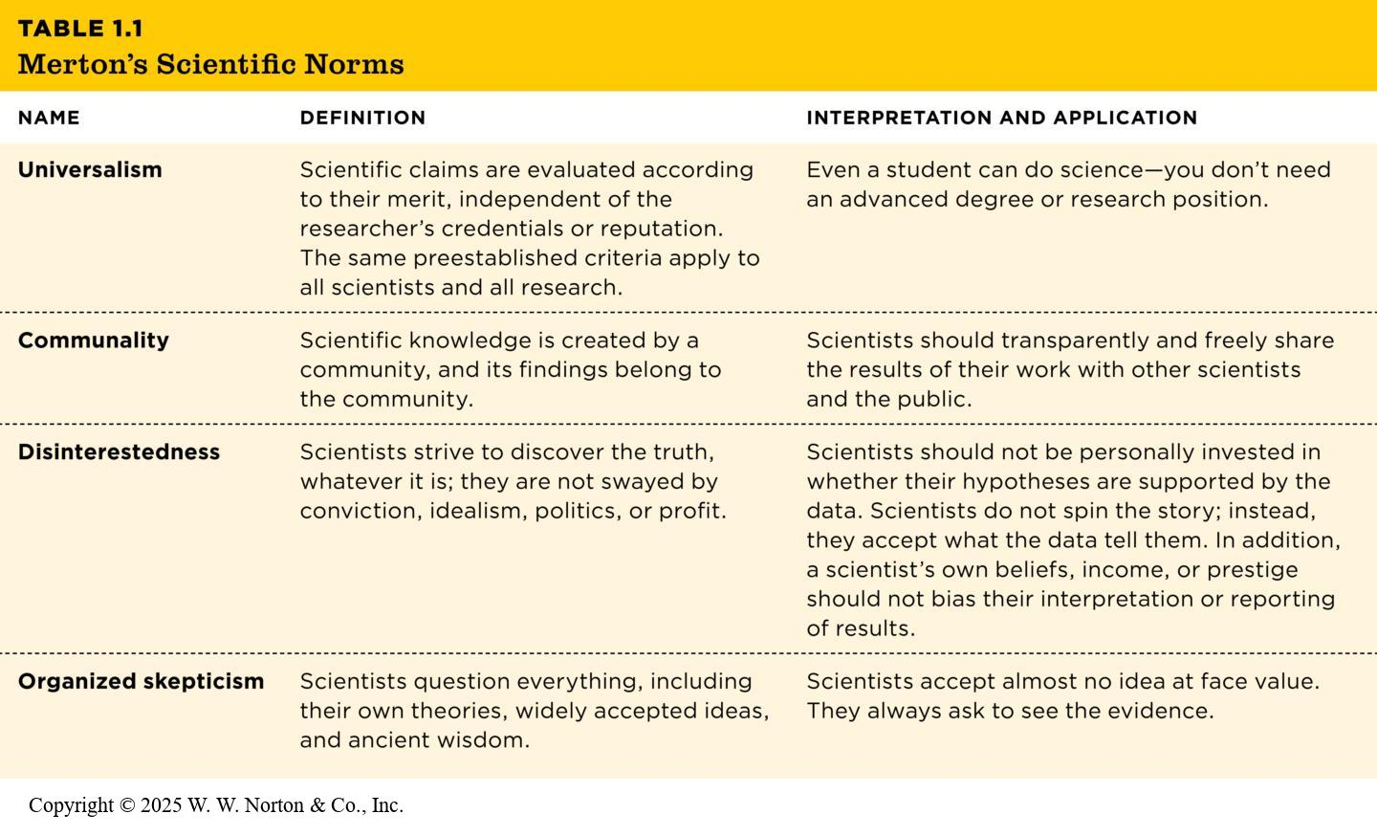
Scientists Work in a Community
Notes:
Table 1.1: Merton’s Scientific Norms
Science can be self-correcting: A process in which scientists make their research available for peer review, replication, and critique, with the goal of identifying and correcting errors in the research.
Representation of scientists matters because people’s identities can shape what they find valuable to study. Further, the representation of study participants also matters to make sure psychology’s research findings apply to other populations.
Copyright © 2025 W. W. Norton & Co., Inc.

Slide 13
Scientists Tackle Applied and Basic Problems (1)
Applied research: It is conducted in order to solve practical problems; the findings will be directly applied to finding a solution to a real-world problem.
  Example: Conducting a study to determine if a new method of teaching language arts is working better than the former one

Slide 14
Scientists Tackle Applied and Basic Problems (2)
Basic research: Its goal is to enhance the general body of knowledge about a particular topic.
  Example: Conducting a study to investigate the limitations of the infant attachment system

Slide 15
Scientists Make Their Work Public
How do scientists share the results of their research with the scientific community?
  Submitting it to a scientific journal
Notes:
What are journals? They are periodicals that typically are published every month. The articles in journals are peer-reviewed and written by qualified contributors. You might explain how the peer-review process works, how it is a gatekeeper for scientific rigor, and how the process can be self-correcting. The audience for journals is scientists and psychology students.

Slide 16
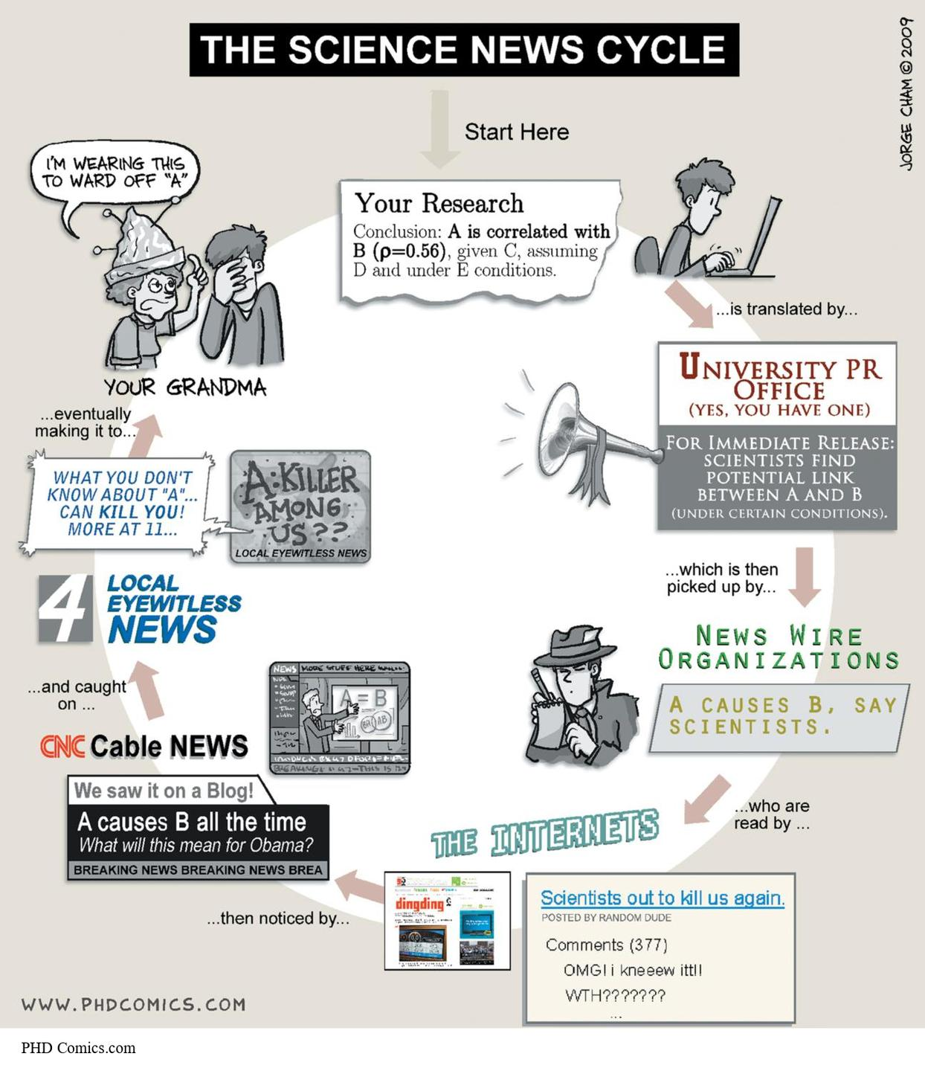
Scientists Talk to the World: From Journal to Journalism
Benefits and risks of journalism coverage
Is the story important?
Is the story accurate?
Notes:
Figure 1.9: Getting It Right
Cartoonist Jorge Cham parodies what can happen when journalists report on scientific research. Here, an original study reported a relationship between two variables. Although the University Public Relations Office relates the story accurately, the strength of the relationship and its implications become distorted with subsequent retellings, much like a game of “telephone.”
Journalism: the popular media or popular press
It’s what most of us read in magazines, newspapers, or online; hear on the radio; or see on TV. These sources are written by journalists, and the audience is the general public. The articles are easy to understand and don’t require specialized knowledge in the field. Journalists usually find out about a research finding by reading about it in a scholarly journal or attending a professional conference, and then they turn the scholarly information into a more accessible news story to reach a wider audience.
PHD Comics.com

